Slide 1
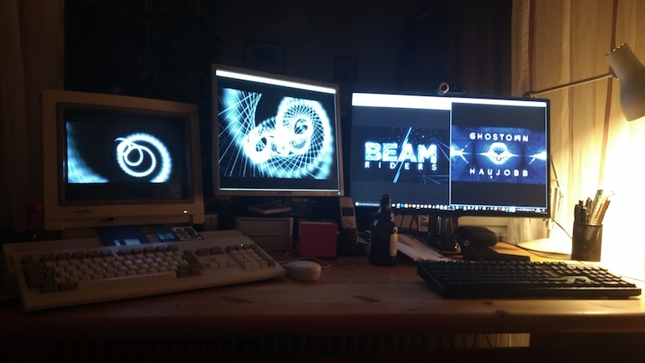
Modern Amiga Demo Cross-Development
Hellfire and Noname

Slide 2
Overview
Comparing „back then“ and now
Cross-Development why and how
Toolchain walkthrough
Syncing
Live-Demo
Beam Riders effects explained
Profiling
Code Optimizations

Slide 3
From „back then“ to now

Slide 4
Prior approaches on Amiga 1/4
Assembly, multiple sources, no encapsulation, timing with constants in ticks (1/50 s)
Heat (1996)
Synergy (1997)
Lessons learnt
Asm-One is nice and quick on 68030 Amiga w. HD (main computer)
Lack of encapsulation costs time
Timing was a pain
Need for demo-system to ease recurring tasks and support coder-collaboration (just joined Haujobb)!

Slide 5
Prior approaches on Amiga 2/4
Assembly, multiple sources, new demosystem providing encapusulation with relocator, display abstraction, timing with script in ticks (catch up)
Mnemonics (1999)
Back to the Roots (2000)
Lessons learnt
Focussing on single effects at a time helps a lot
Basic APIs eased coder collaboration on Amiga
Still no proper linking and higher level-language support

Slide 6
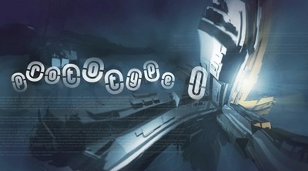
Prior approaches on Amiga 3/4
Restarted hobby with Hellfire
Prototype 1 (2010)
Mixing C and assembly language with old demosystem
Linker support through objects
Toolchain: Devpac, vbcc, vasm, vlink, GNU make, Visual Studio
Lessons learnt
Display abstraction API for prototyping on PC is handy
Assembling and compiling in WinUAE is a time-waster
Testing on real Amiga is mandatory
Artists love modern tools and PC test-exes while tweaking assets
Less time due to Real Life TM
Demo-making is still fun ☺

Slide 7
Prior approaches on Amiga 4/4
Cross-Compile, 1st try
Last Train to Danzig (2015)
Internal developer build runs natively on PC
Release cross-compiled for Amiga under Windows
native Amiga bindings assembled with Devpac on Amiga
Tools: vbcc, vasm, vlink, gnu make
No more file-bundles
Asset loader for graphics files
Timing still based on ticks
IDE: QtCreator

Slide 9
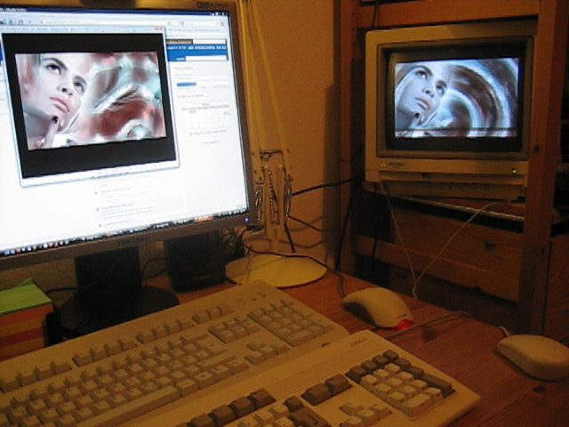
Why develop for Amiga on PC?
20 years ago, Amiga was the main machine
Edited in 640x256 (PAL) or 640x400 (Euro72)
Assemble on 68060 with 50 MHz
Today, PC is just more productive
Edit in 1920x1080 (Full HD), dual head
Compile on Core i7 with 3 GHz
In essence:
Bigger monitors
Better tools (IDE, debugger)
Faster, i.e. quicker turn-around times

Slide 10
Cross-Development
How we do it

Slide 11
Shopping List for an 060 Demo
Display abstraction (16:9)
APIs from demo-system with C2P on Amiga
Qt-based rewrite on PC
Streaming sound
ADPCM on Amiga
MP3 on PC
Musician happy
Build paths
For PC in Qt Creator
For Amiga: cross-compile
WinUAE
Real Amiga 060 (important!)
Misc
Network share
Version control

Slide 12
Demosystem API overview
Amiga
PC
C2P screenmodes (25)
also with Copper-gradients, saturation, truecolour, OCS
Rocket-Integration
Streaming audio
Profiler
Compatible on API-level
No emulation
Rocket-Integration
Profile Viewer

Slide 13
Typical Use-Cases
PC
Amiga
Code and tweak effects
Auto-reload for assets
Graphics guy happy
Integrate and time demo
Again: demo runs native
Rocket editor
Run WinUAE
WinUAE
Test compiles, effects, demo
Eye-balling for errors
Approximate performance
CPU Speed setting to 350%
Real Amiga
Check on CRT
Profiling

Slide 14
Live-Demo now!

Slide 15
Beam Riders explained

Slide 16
Motivations
„Let's visit that party and bring a demo along!“
not much time
not much content
visual limitations (low resolution, few colors)
how can we stand out?
Aesthetic approaches
Dithering
Antialiasing
Subpixel Rendering

Slide 17
Dithering

Slide 18
Antialiasing

Slide 19
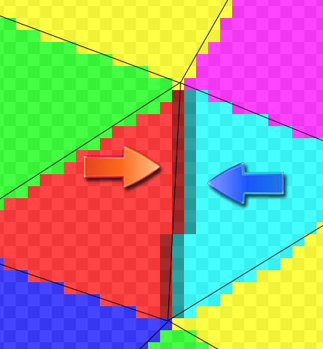
Antialiasing
Multisampling is much too expensive!
Smooth the edges with antialiased lines
Line routine must have exactly the same rounding as poly-filler!
Line exactly on two neighboring triangles
Read 2 screen pixels and interpolate acording to lines x-coordinate

Slide 20
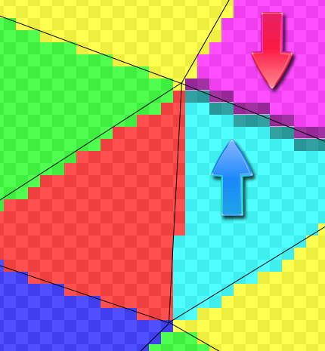
Antialiasing
The same for horizontal lines...

Slide 21
Subpixel rendering

Slide 22
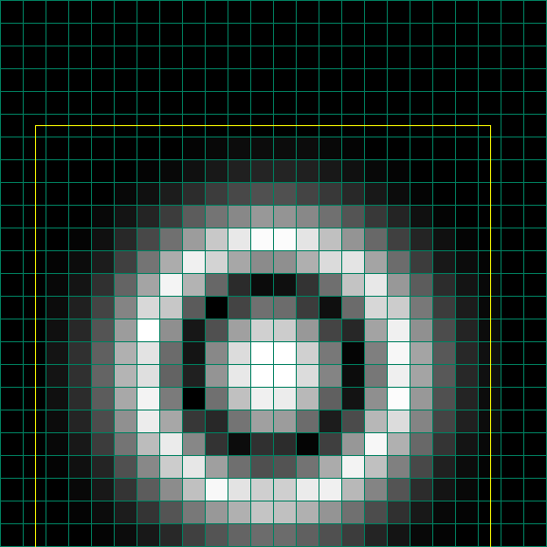
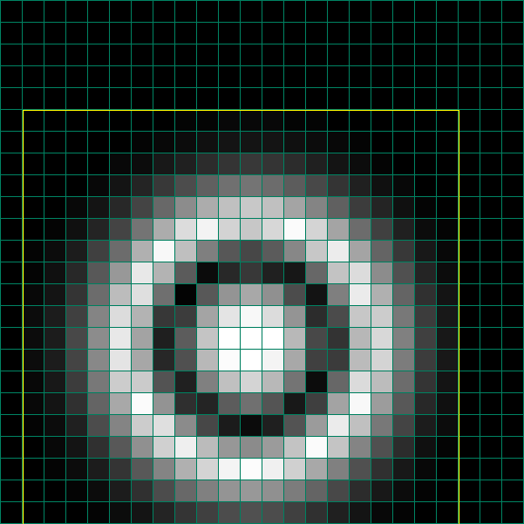
Subpixel rendering
Smoothly blend through pixels
Moves only by whole pixels, slow movements are not possible

Slide 23
Subpixel Rendering
Bilinear filtering is too expensive
Let's precalculate:
Just need to copy this to screen
Köln
Precalc
Verbot
X=0,0
X=0,25
X=0,5
X=0,75
X=1,0

Slide 24
Getting things faster
Highlevel optimizations
Cache optimizations
Assembler optimizations
What to do first?
You need a bit of optimization before you see Cache limitations.
And Cache optimization often requires different highlevel structures.
So let's look at the Cache first...

Slide 25
What is the Cache?
You access one byte
Address (low 4 bits)
9 | A | B | C | D | E | F | 0 | 1 | 2 | 3 | 4 | 5 | 6 | 7 | 8 | 9 | A | B | C | D | E | F | 0
T | h | i | s |  | i | s |  | j | u | s | t |  | a | n |  | e | x | a | m | p | l | e
Data
CPU reads 16 bytes into the Cache
Use data from the Cacheline because it's „just there“ now.
512 Cachelines are available (fetching a new Cacheline takes about 20 cycles)
When new data comes in, old data goes out

Slide 26
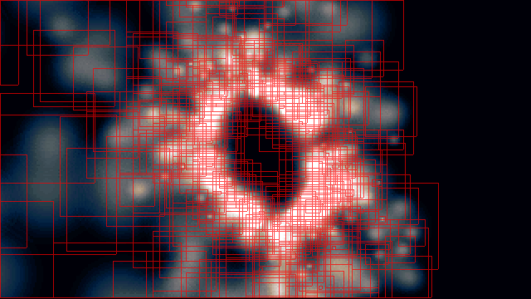
Using the Cache
Let's analyze one rendered frame
337 additive particles visible
298.560 pixels set (a lot of overdraw)
Simple render code:
Read pixel from texture
Read pixel from screen
Add and write back

Slide 27
Using the Cache
What do we expect?
We always read one pixel from the texture and one pixel from the screen.
→ The Cache should contain half texture and half screen data (4kB each)
We always read linearly from left to right.
→ Every 16th pixel we hit a new Cacheline. The next 15 Pixel are for free.
We use many prescaled textures (about 1500kB of data)
→ Unlikely that we can reuse much of the texture data
Many particles cover the same screen area (screen buffer is 58kB)
→ Possible to reuse screen data which is still in the Cache

Slide 28
Using the Cache
Simple drawing approach:
Draw each particle individually
Order is given by particle generator
Rather random screen positions
Don't expect much Cache reuse
About 21.000 Cache misses (every 15th pixel, just as expected!)

Slide 29
Using the Cache
Simple optimization:
Draw particles top to bottom
Pixels „below“ were recently drawn
Expect better Cache reuse
About 12.000 Cache misses
(Almost half as much!)

Slide 30
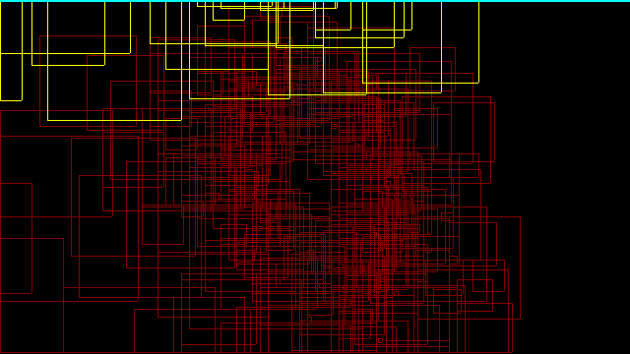
Using the Cache
More sophisticated approach:
Fill every scanline completely
Keep track of particles which cross the current scanline
Clear loads scanline into Cache
3.600 Cache misses Every Cacheline is loaded only once → Can't do any better!

Slide 31
Using the Cache
So how much time did we save?...
Theory:
Reduced Cache misses from 21.000 to 3.600.
A Cache miss stalls until the requested data is loaded
(first byte is available earlier than the last byte)
We are always waiting for the first DWord to arrive (available after 8 Cycles)
Saved ~140.000 cycles (that's about 5% of our available frame time)

Slide 32
Profiling
We need a way to track where our performance is spend:
Record the timing for every frame.
Save to file at exit.
void drawFrame(int time)
{
profileStart(1); doSetup(...); profileStop(1);
profileStart(2); doTransform(...); profileStop(2);
profileStart(3); doClip(...); profileStop(3);
profileStart(4); doDraw(...); profileStop(4);
}

Slide 33
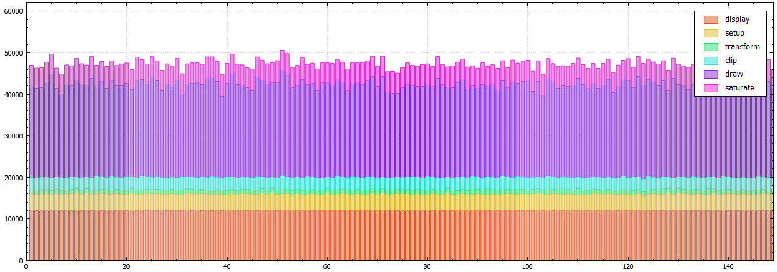
Profiling
Results for drawing particles one after another:
20.000 (20ms) is one PAL frame (1/50sec), all frames reach into the 3rd frame and run at 17 Fps.

Slide 34
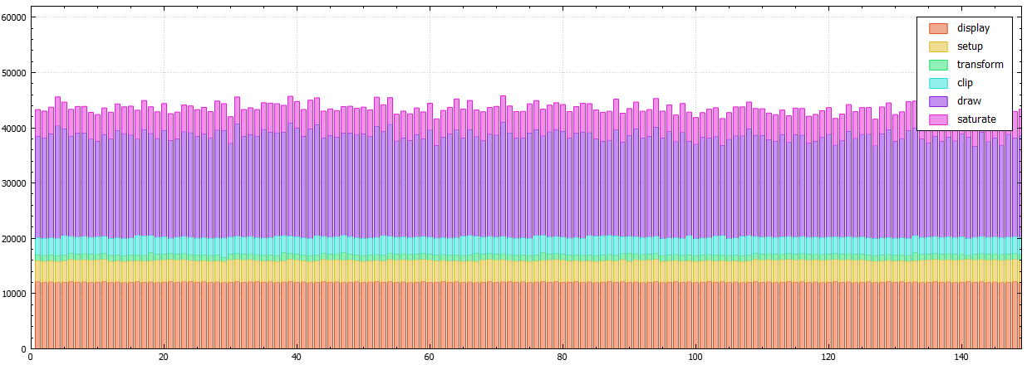
Profiling
Results for drawing scanlines top to bottom:
Saved ~3.5ms. That's about 230.000 cycles – more than expected (a rare occasion!)

Slide 35
Assembler Optimizations

Slide 36
Optimizing Code
Let's have a look at the code
and what the compiler does to it
Most critical part:
Function to add pixels
Called 7500 times per frame

Slide 37
Optimizing Code
static void addPixels(
uint* dst, // screen buffer uint* src, // texture buffer int count // num pixels / 4
)
{
do {
ASMCOMMENT("addPixels loop")
uint d0= *src++; // read 32bit (4 pixels) from texture
uint d1= *dst; // read 32bit (4 pixels) from screen
d0+= d1; // add 4 pixels in parallel
*dst++= d0; // write result back to screen
} while (--count);
}

Slide 38
Optimizing Code
Let's see what the compiler did!
The code was so simple...
What could possibly go wrong?!

Slide 39
Optimizing Code
a1= src // texture buffer a2= dst // screen buffer d4= count // num pixels / 4
a7= pointer to stack l1441
; addPixels loop // from ASMCOMMENT macro
move.l (a1)+, d0 // d0= *src++
move.l (a2), d1 // d1= *dst
move.l d2, -(a7) // save d2 to stack ?!
move.l d1, d2 // temp copy of d1 ?!
add.l d0, d2 // d2+= d0
move.l d2, (a2)+ // store back to screen
move.l (a7)+, d2 // restore d2 from stack ?!
subq.l #1, d4 // count--
bne l1441 // while (count!=0) ...
Compiler Output:
Half of the instructions
are redundant...

Slide 40
Optimizing Code
void MODIFIED(“a1/a2/d0/d1/d4") addPixels(
INPUT(“a2") uint* dst, // screen buffer
INPUT("a1") uint* src, // texture buffer
INPUT(“d4") int count // num pixels / 4
) = "\t"
".addLoop "
" move.l (a1)+, d0 " // d0= *src++
" move.l (a2), d1 " // d1= *dst
" add.l d0, d1 " // d1+= d0
" move.l d1, (a2)+ " // store back to screen
" subq.l #1, d4 " // count--
" bne .addLoop " // while (count!=0) ...
;
Remove unnecessary instructions
Inline into C-Source

Slide 41
Code execution (on 68060)
.addLoop:
move.l (a1)+, d0
free instruction on 2nd pipeline
move.l (a2)+, d1 // only 1 cache access per cycle
free instruction on 2nd pipeline
add.l d0, d1 // not possible until d0/d1 are loaded
free instruction on 2nd pipeline
move.l d1, (a2)+
subq.l #1, d4 // works on 2nd pipeline
bne .addLoop // for free if „predicted“
4 cycles per iteration. 3 free instruction slots.

Slide 42
… and no matter how hard you try

Slide 43
Wrap up
Modern cross development tools are available
Editing tools facilitate demo making
Our tool chain will be made available
Try it out for yourself!

